Slide 1
Recurrent Neural Networks for Speech Recognition
CSCI 4961/6961 Group 6

Slide 2
“Speech Recognition with Deep Recurrent Neural Networks”
by Alex Graves, Abdel-rahman Mohamed and Geoffrey Hinton
From the Department of Computer Science at University of Toronto
Published in 2013
Graves, A., Mohamed, A. R., & Hinton, G. (2013, May). Speech recognition with deep recurrent neural networks. In 2013 IEEE international conference on acoustics, speech and signal processing (pp. 6645-6649). IEEE.
Notes:
For our pedagogical project, we will be covering the paper “Speech recognition with Deep Recurrent Neural Networks” by Alex Graves, Abdel-rahman Mohamed, and Geoffrey Hinton from the department computer science at University of Toronto. This paper was published in 2013 in the IEEE International Conference on Acoustics, Speech, and Signal Processing.

Slide 3
Model Definition

Slide 4
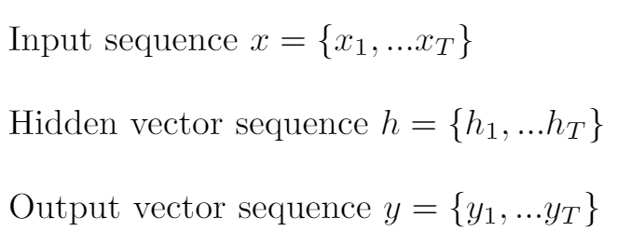
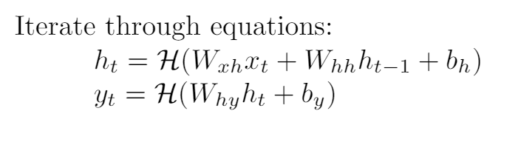
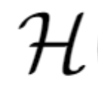
Recurrent Neural Networks
denotes the hidden layer function
Notes:
The groundwork of the model introduced in this paper is based on recurrent neural network architecture. Given an input sequence x, an RNN computes the hidden vector sequence h and output vector y. It does this by iterating, from 1 to T through the following two equations, where W is the weight matrices and b is the bias vectors. For example, Wxh denotes the weights between the input layer and a hidden layer, and bh denotes the bias of the hidden layers. H denotes the hidden layer function, which is often an elementwise application of a sigmoid function, however in this paper they implement this function as long short-term memory cell architecture.

Slide 5
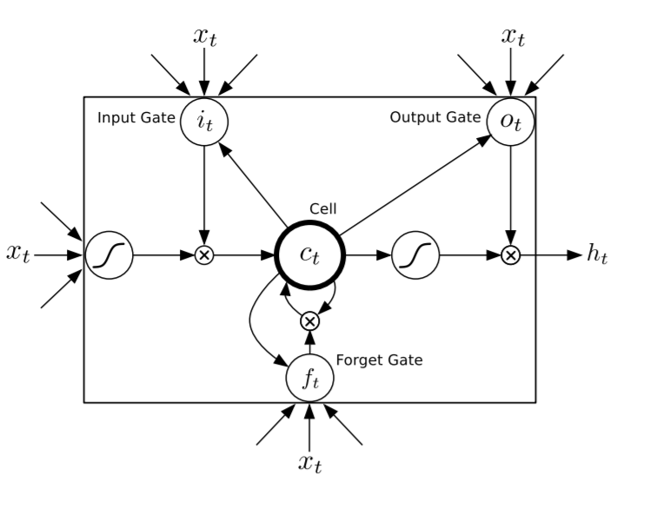
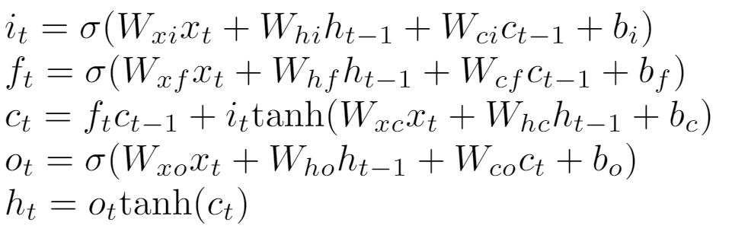
Long Short-Term Memory
A common implementation for the hidden layer function, which allows for processing of sequences such as speech, where a sound can be stored across multiple input segments.
The implementation found in the paper:
Notes:
Long short-term memory architecture is not new or innovative from this paper. It is a common implementation for an RNN hidden layer function, which is well suited for processing sequences such as speech, where a single sound may be stored across multiple input segments and it is useful for the model to have memory of previous states. The implementation in this paper uses the architecture of the figure on the right along with the compound function given on the left to compute the hidden vector ht from weight matrices.

Slide 6
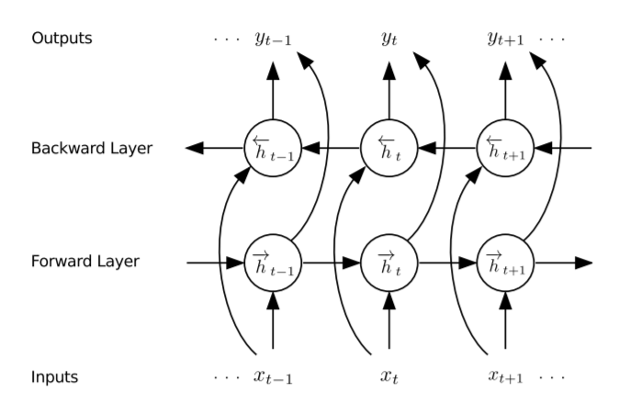
Bidirectional RNN
This paper also uses Bidirectional RNNs, which uses “future” information as well as past information, by running a parallel hidden layer that iterates x from T to 1 instead of 1 to T
Notes:
A downside of a conventional RNN is that they are limited to only using previous information. The model in the paper utilizes bidirectional RNN aspects that can access future information as well as past information. It does this by processing the data in both directions with two parallel hidden layers, the backwards one that iterates from T to 1 and the forward one iterating from 1 to T. These separate hidden layers are then combined to into the same output layer.

Slide 7
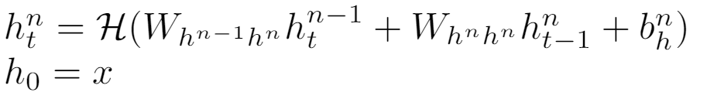

Deep Recurrent Neural Networks
Deep RNNs are created by stacking multiple hidden layers on top of eachother.
The stacking of layers may provide a similar effect as a deep NN, as this method introduces distinct inter-layer weights, rather than just the recurrent layer weights
The concept of Deep RNNs were introduced and reported on for the first time in this paper
Notes:
The unique aspect of the model in the paper, is the application of deep network architectures along with long short term memory and bidirectionality. Deep RNNs are made by stacking multiple hidden layers on top of eachother where the output of one layer forms the input for the next. Stacking layers like this can provide the effect of a deep network, as this method uses inter-layer weights and every hidden layer receives input from the forward and backward layers at the level below allowing for maximum interconnection. Combining all these model features gives us the deep bidirectional long short term memory RNN network and the paper claims this is the first time this architecture has been applied to speech recognition.

Slide 8
Network Training

Slide 9
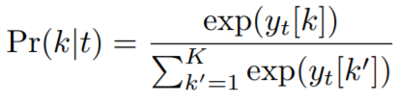
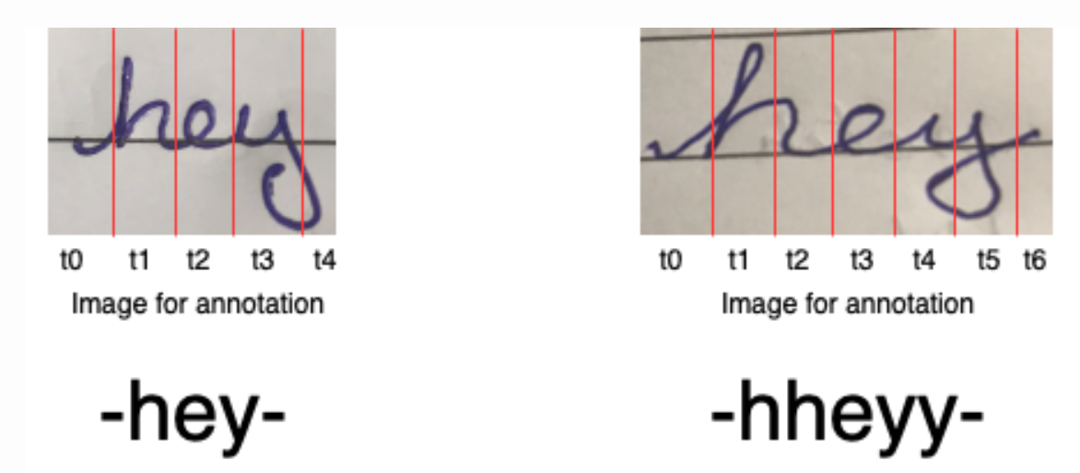
Connectionist Temporal Classification (CTC)
CTC is an function for obtaining a differentiable probabilistic output from RNNs
Method was also developed by Alex Graves in 2006
Uses a “blank” output along with a forward-backward summation algorithm to handle time sequences that have the same output

Slide 10
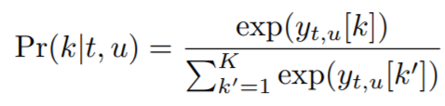
RNN Transducer
A model architecture also proposed by Alex Graves one year prior
Uses two RNNs, one called the transcriber and another called the predictor
In this paper, the transcriber network is the Deep RNN and the predictor is another RNN that uses the output from the CTC function to predict the alignment of characters to produce the output
The predictor models use a modified BFS algorithm called Beam Search to find optimal probability distributions that take into account all combinations of time input and possible outputs

Slide 11
Paper Results and Conclusions

Slide 12
Dataset used
TIMIT corpus for phoneme recognition
630 speakers reading phonetically hard sentences
Audio files labeled with phonetic spellings
Commonly used in speech recognition and transformation learning

Slide 13
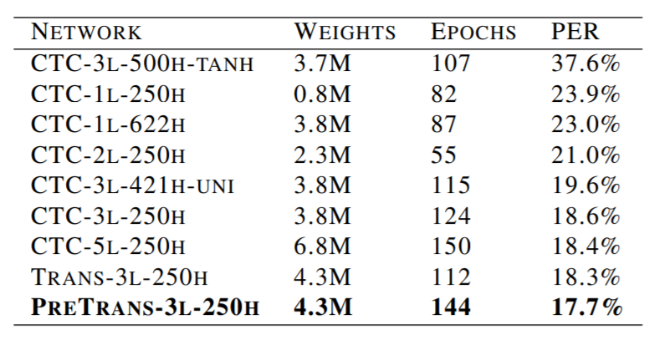
Model Comparison
CTC vs. Transduction vs. Pre Transduction
1 vs 3 vs 5 layer Deep RNN
Various sizes LSTM nodes per layer
All trained with SGD w/ momentum
All used beam search with 100 width
-tanh and -uni did not use LSTM and used respective H function

Slide 14
Results/Conclusions
Increase in amount of hidden layers for CTC decreased error rate
Depth of Deep RNN affects the results more than the size of the hidden layer
The data was well represented by this model and the combination of Deep, Bidirectional RNNs with LSTMs provided state of the art error % (It was the best at the time)

Slide 15
Implementation

Slide 16
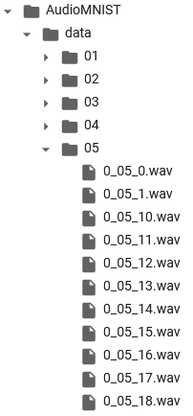
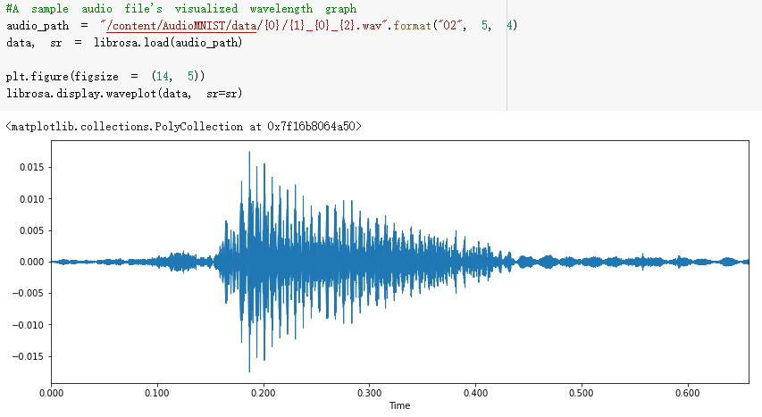
Data Preprocessing

Slide 17
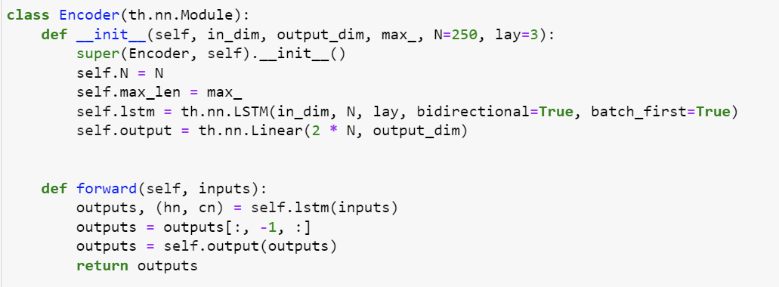
Encoder/Decoder

Slide 18
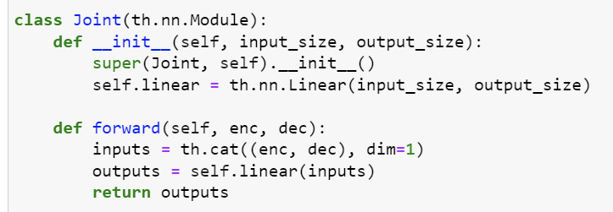
Combination

Slide 19
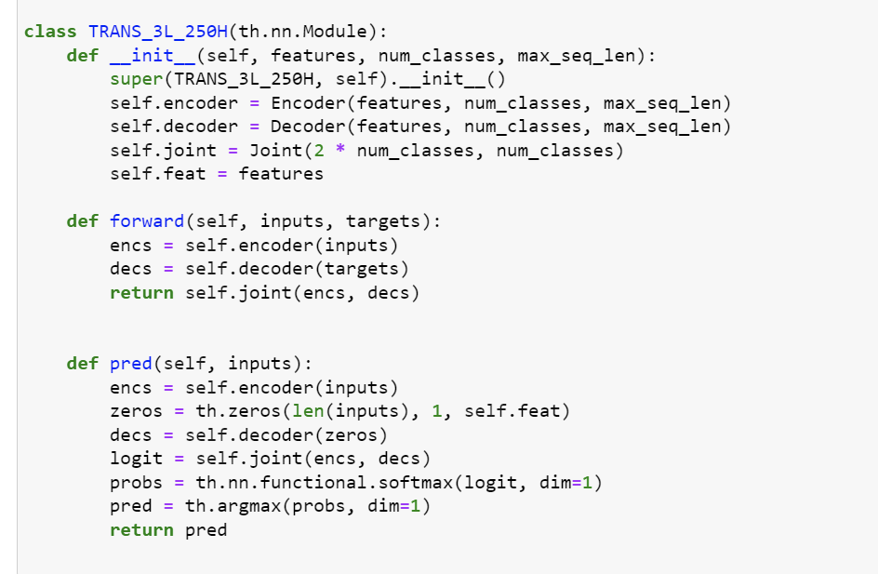
Full

Slide 20
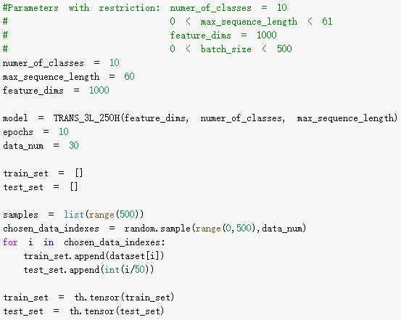
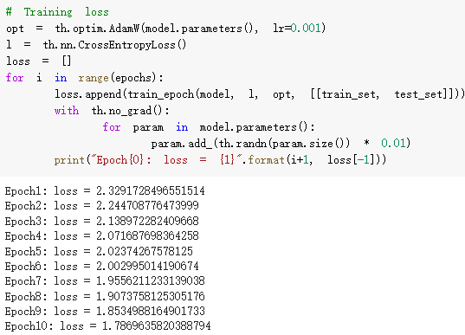
Training

